Slide 1

Machine Learning for Engineers: K-Nearest Neighbors (KNN)
Mina Farmanbar
Associate Professor, University of Stavanger
for engineers

Slide 2
K-Nearest Neighbors (KNN)
Is a simple, easy-to-implement
Is a supervised machine learning algorithm that can be used to solve both:
Classification
Regression problems
Similar points can be found near one another

Slide 3
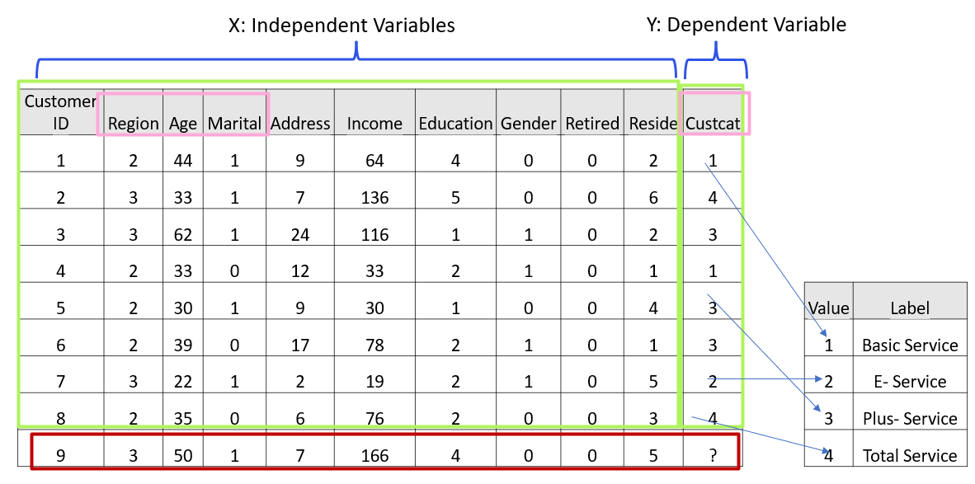
K-Nearest Neighbors (KNN)

Slide 4
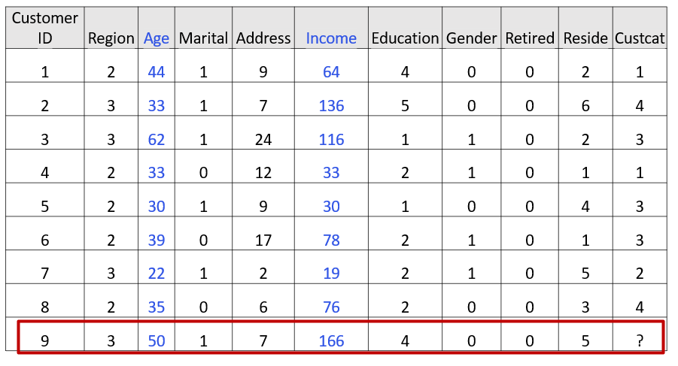
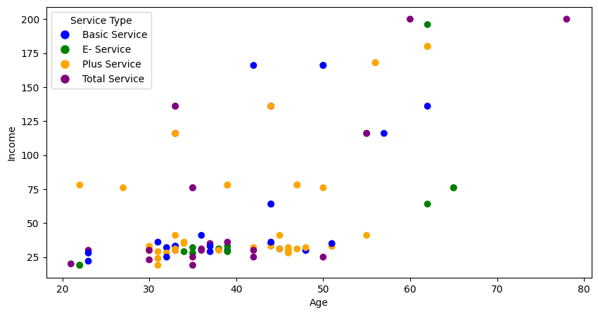
Classification using 1st KNN
?

Slide 5
Classification using 1st KNN
?
K = 1, Predicted Class is : Class#1 (Basic Service)

Slide 6
Classification using 1st KNN
?
K = 3, Predicted Class is : Class#3 (Plus Service)
6

Slide 7
K-Nearest Neighbors
The K-Nearest Neighbors algorithm:
Takes a bunch of labeled points and uses them to learn how to label other points.
It classifies cases based on their similarity to other cases.
The distance between two cases is a measure of their dissimilarity.

Slide 8
K-Nearest Neighbors Algorithm
Pick a value for K.
Calculate the distance of a new case from all cases in the dataset.
Search for the K-observations in the training data that are nearest to the unknown data point.
Predict the class label of the unknown data point using the K-Nearest Neighbors.

Slide 9
K-Nearest Neighbors Algorithm Life
How to select the correct K?
How to compute the similarity between cases?

Slide 10
How to select the correct K?
K in the K-Nearest Neighbors is the number of nearest neighbors to examine.
It is supposed to be specified by the user.
So, how do we choose the right K?

Slide 11
How to select the correct K?
K = 1 Class 1
K = 20 ?
?

Slide 12
How can we find the best value for K?
Reserve part of your data for testing the model's accuracy.
Start with K = 1, train the model, and test it using the reserved data to calculate accuracy.
Increase K and repeat the process, checking accuracy each time.
Choose the K that gives the best accuracy for your model.

Slide 13
How to select the correct K?
K = 4 Class 3
?

Slide 14
K-Nearest Neighbors (KNN)
How to compute the similarity between cases?

Slide 15


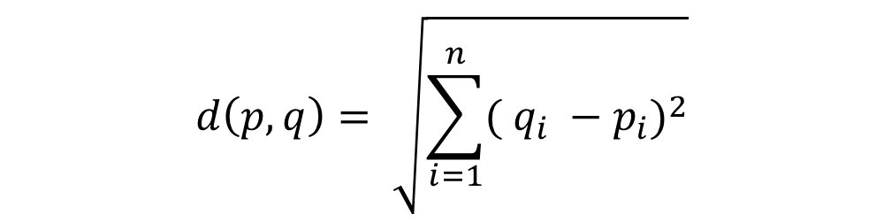

Computing the similarity between cases
$$d\left(p,q\right)= \sqrt{\sum_{i=1}^{n}{{( q_{i} −p_{i})}^{2}}}$$
Customer 1
Age
34
Customer 2
Age
30
$$= \sqrt{{( 34 −30)}^{2}}=4$$
Euclidean distance

Slide 16
Computing the similarity between cases
$$d\left(p,q\right)= \sqrt{\sum_{i=1}^{n}{{( q_{i} −p_{i})}^{2}}}$$
Customer 1
Age | Income
34 | 190
Customer 2
Age | Income
30 | 200
$$= \sqrt{{( 34 −30)}^{2}+{( 190 −200)}^{2}} = 10.77$$
Features for the firts data point
Features for the second data point

Slide 17
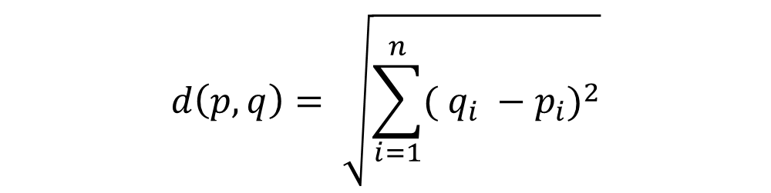
Computing the similarity between cases
$$d\left(p,q\right)= \sqrt{\sum_{i=1}^{n}{{( q_{i} −p_{i})}^{2}}}$$
Customer 1
Age | Income | Education
34 | 190 | 3
Customer 2
Age | Income | Education
30 | 200 | 8
$$= \sqrt{{( 34 −30)}^{2}+{( 190 −200)}^{2}+{( 3 −8)}^{2}} =11.87$$

Slide 18
K-Nearest Neighbors (KNN)
Of course, we have to normalize our feature set to get the accurate dissimilarity measure.

Slide 19
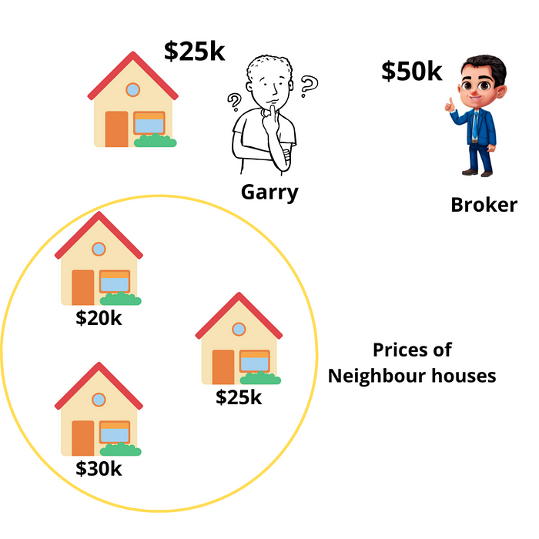
Regression using KNN
Nearest neighbors analysis can also be used to predict continuous values.
In this case, we use the average or median value of the nearest neighbors to make a prediction.
https://miro.medium.com/v2/resize:fit:720/format:webp/0*gC_KP-oRRxCZXLqb.png

Slide 20
Thank you
Mina Farmanbar
mina.farmanbar@uis.no

